Slide 1
CHAPTER 7
SIMULTANEOUS PERTURBATION STOCHASTIC APPROXIMATION (SPSA)
Slides for Introduction to Stochastic Search and Optimization (ISSO) by J. C. Spall
Organization of chapter in ISSO
  Problem setting
  SPSA algorithm
  Theoretical foundation
  Asymptotic normality and efficiency
  Practical guidelines—MATLAB code
  Numerical examples
  Extensions and further results
  Adaptive simultaneous perturbation method
Additional information available at www.jhuapl.edu/SPSA
(selected references, background articles, MATLAB code, and video)

Slide 2
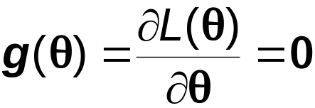
A. PROBLEM SETTING AND SPSA ALGORITHM
Consider standard minimization setting, i.e., find root θ∗ to
where L(θ) is scalar-valued loss function to be minimized and θ is p-dimensional vector
Assume only (possibly noisy) measurements of L(θ) available
  No direct measurements of g(θ) used, as are required in stochastic gradient methods
Noisy measurements of L(θ) in areas such as Monte Carlo simulation, real-time control/estimation, etc.
Interested in p > 1 setting (including p >> 1)
7-<number>

Slide 3



SPSA Algorithm
Let (θ) denote SP estimate of g(θ) at kth iteration
Let denote estimate for θ∗ at kth iteration
SPSA algorithm has form
where {a_{k}} is nonnegative gain sequence
Generic iterative form above is standard in SA; stochastic analogue to steepest descent
Under conditions, → θ∗ in “almost sure” (a.s.) stochastic sense as k→∞
7-<number>

Slide 4
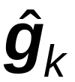

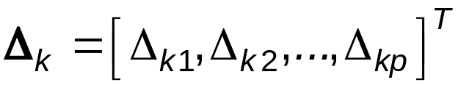


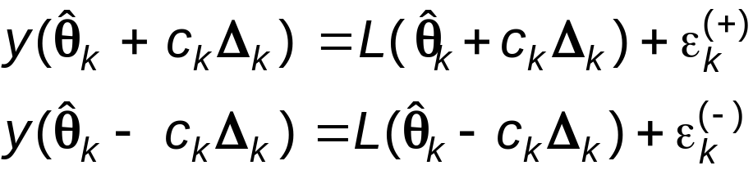


Computation of (•) (Heart of SPSA)
Let be vector of p independent random variables at kth iteration
typically generated by Monte Carlo
Let {c_{k}} be sequence of positive scalars
For iteration k → k+1, take measurements at design
levels:
where are measurement noise terms
Common special case is when
(e.g., system identification with perfect measurements
of the likelihood function)
7-<number>

Slide 5


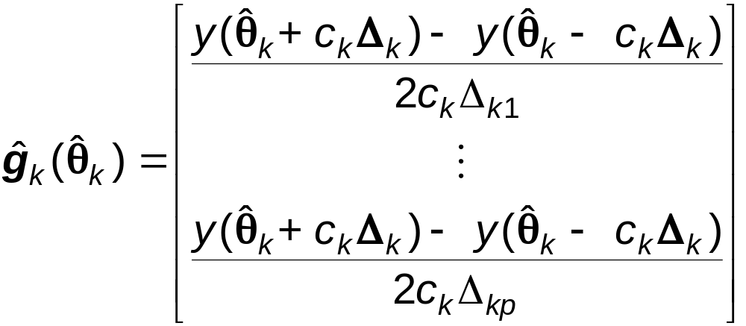

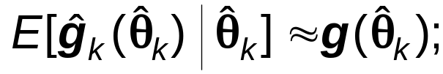
Computation of (•) (cont’d)
The standard SP form for (•):
Note that (•) only requires two measurements of L(•) independent of p
Above SP form contrasts with standard finite-difference approximations taking 2p (or p+1) measurements
Intuitive reason why (•) is appropriate is that
formalized in Section B
7-<number>

Slide 6

Essential Conditions for SPSA
To use SPSA, there are regularity conditions on L(θ), choice
of Δ_{k} , the gain sequences {a_{k}}, {c_{k}}, and the measurement noise
  Sections 7.3 and 7.4 of ISSO present essential conditions
Roughly speaking the conditions are:
A. L(θ) smoothness: L(θ) is thrice differentiable function
(can be relaxed—see Section 7.3 of ISSO)
B. Choice of Δ_{k} distribution: For all k, Δ_{k} has independent components, symmetrically distributed around 0, and
  Bounded inverse moments condition is critical (excludes
  Δ_{ki} being normally or uniformly distributed)
  Symmetric Bernoulli Δ_{ki} = ±1 (prob = ½ for each outcome)
  is allowed; asymptotically optimal (see Section F or Section 7.7 of ISSO)
7-<number>

Slide 7
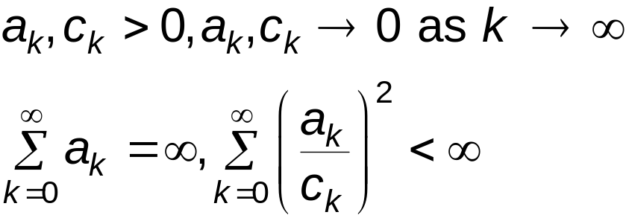
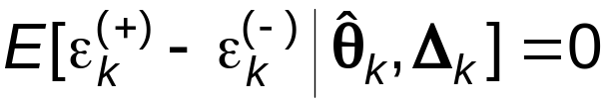

Essential Conditions for SPSA (cont’d)
C. Gain sequences: standard SA conditions:
(better to violate some of these gain conditions in certain practical problems; e.g., nonstationary tracking and control where a_{k} = a > 0, c_{k} = c > 0 ∀ k, i)
D. Measurement Noise: Martingale difference
  ∀ k sufficiently large. (Noises not required to be independent of each other or of current/previous and Δ_{k} values.) Alternative condition (no martingale mean 0 assumption needed) is that be bounded ∀ k
7-<number>

Slide 8
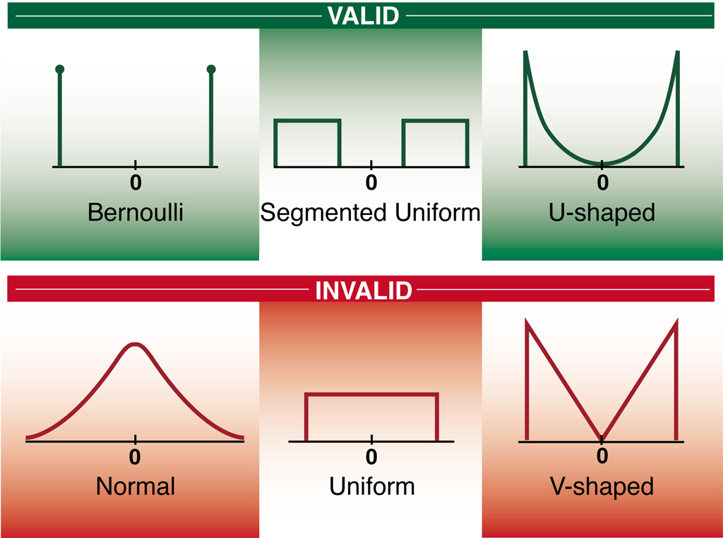
Valid and Invalid Perturbation Distributions
7-<number>

Slide 9
B. THEORETICAL FOUNDATION
Three Questions
Question 1: Is (•) a valid estimator for g(•)?
Answer: Yes, under modest conditions.
Question 2: Will the algorithm converge to θ∗ ?
Answer: Yes, under reasonable conditions.
Question 3: Do savings in data/iteration lead to a corresponding savings in converging to optimum?
Answer: Yes, under reasonable conditions.
7-<number>

Slide 10


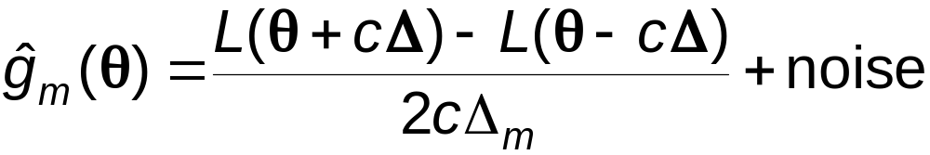
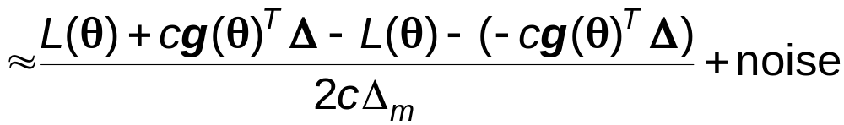
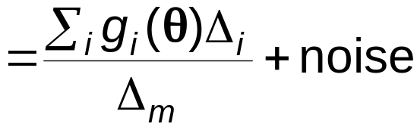
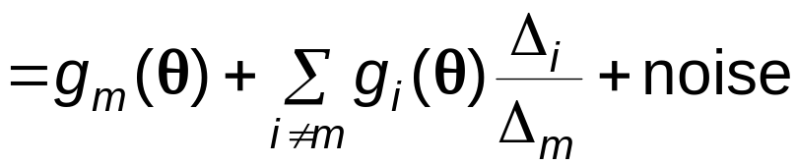

Near Unbiasedness of (•)
SPSA stochastic analogue to deterministic algorithms if is “on average” same as g(θ) for any θ
Suppressing iteration index k, mth component of is:
With we have for any m:

Slide 11
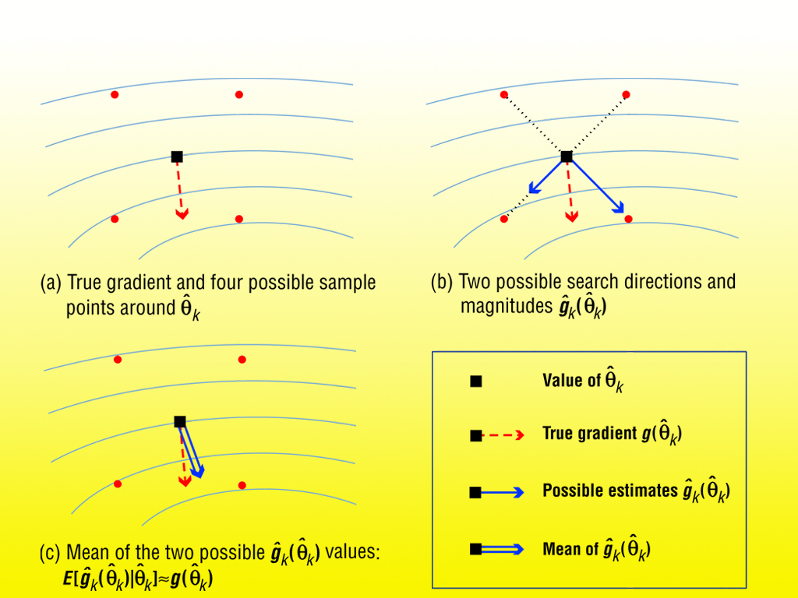
Illustration of Near-Unbiasedness for (•) with p = 2 and Bernoulli Perturbations
7-<number>
7-<number>

Slide 12

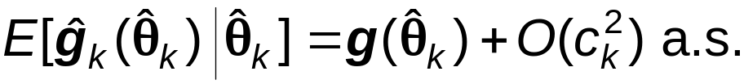


Theoretical Basis (Sects. 7.3 – 7.4 of ISSO)
Under appropriate regularity conditions (e.g.,
thrice continuously differentiable, is martingale difference noise, etc.), we have:
Near Unbiasedness
Convergence:
Asymptotic Normality:
where μ, Σ, and β depend on SA gains, Δ_{k} distribution, and shape of L(θ)
7-<number>

Slide 13
Efficiency Analysis
Can use asymptotic normality to analyze relative efficiency of SPSA and FDSA (Spall, 1992; Sect. 7.4 of ISSO)
Analogous to SPSA asymptotic normality result, FDSA is also asymptotically normal (Chap. 6 of ISSO)
  The critical cost in comparing relative efficiency
  of SPSA and FDSA is number of loss function measurements y(•), not number of iterations per se
Loss function measurements represent main cost (by far)—other costs are trivial
Full efficiency story is fairly complex—see Sect. 7.4 of ISSO and references therein
7-<number>

Slide 14
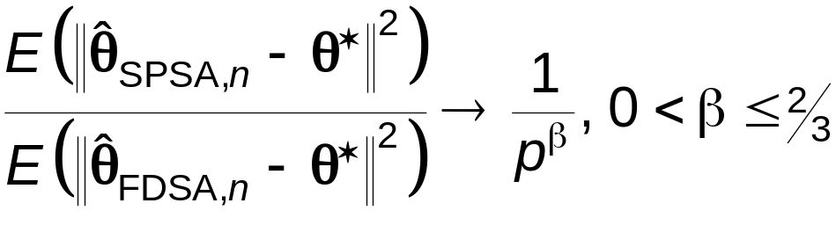

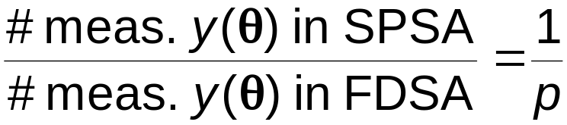
Efficiency Analysis (cont’d)
Will compare SPSA and FDSA by looking at relative mean square error (MSE) of θ estimate
Consider relative MSE for same no. of measurements, n
(not same no. of iterations). Under regularity
conditions above:
  (∗)
Equivalently, to achieve same asymptotic MSE
  (∗∗)
Results (∗) and (∗∗) are main theoretical results
justifying SPSA
7-<number>

Slide 15
Paraphrase of (∗∗) above:
SPSA and FDSA converge in same number of iterations despite p-fold savings in cost/iteration for SPSA
— or —
One properly generated simultaneous random change of all variables in a problem contains as much information for optimization as a full set of one-at-a-time changes of each variable
7-<number>

Slide 16




C. PRACTICAL GUIDELINES AND
MATLAB CODE
The code below implements SPSA iterations k = 1,2,...,n
  Initialization for program variables theta, alpha, etc. not shown since that can be handled in numerous ways (e.g., file read, direct inclusion, input during execution)
  elements are generated by Bernoulli ±1
  Program calls external function loss to obtain y(θ) values
Simple enhancements possible to increase algorithm stability and/or speed convergence
  Check for simple constraint violation (shown at bottom of sample code)
  Reject iteration if is too much greater than (requires extra loss measurement per iteration)
  Reject iteration if is too large (does not require extra loss measurement)
7-<number>

Slide 17
Matlab Code
for k=1:n
  ak=a/(k+A)^alpha;
  ck=c/k^gamma;
  delta=2*round(rand(p,1))-1;
  thetaplus=theta+ck*delta;
  thetaminus=theta-ck*delta;
  yplus=loss(thetaplus);
  yminus=loss(thetaminus);
  ghat=(yplus-yminus)./(2*ck*delta);
  theta=theta-ak*ghat;
end
theta
If maximum and minimum values on elements of theta can be specified, say thetamax and thetamin, then two lines can be added below theta update line to impose constraints:
  theta=min(theta,thetamax);
  theta=max(theta,thetamin);
7-<number>
7-<number>

Slide 18
D. APPLICATION OF SPSA
Numerical Study: SPSA vs. FDSA
Consider problem of developing neural net controller (wastewater treatment plant where objectives are clean water and methane gas production)
Neural net is function approximator that takes current information about the state of system and produces control action
L_{k}(θ) = tracking error,
θ = neural net weights
Need to estimate θ in real-time; used nondecaying a_{k} = a, c_{k} = c due to nonstationary dynamics
p = dim(θ) = 412
More information in Example 7.4 of ISSO
7-<number>

Slide 19
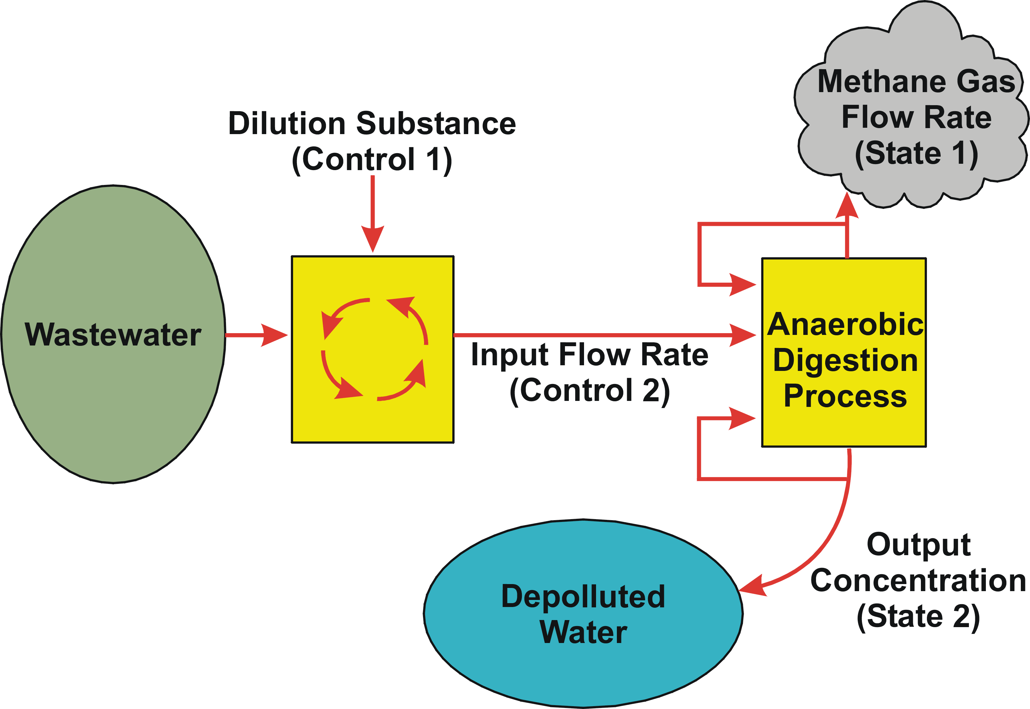
Wastewater Treatment System
7-<number>

Slide 20
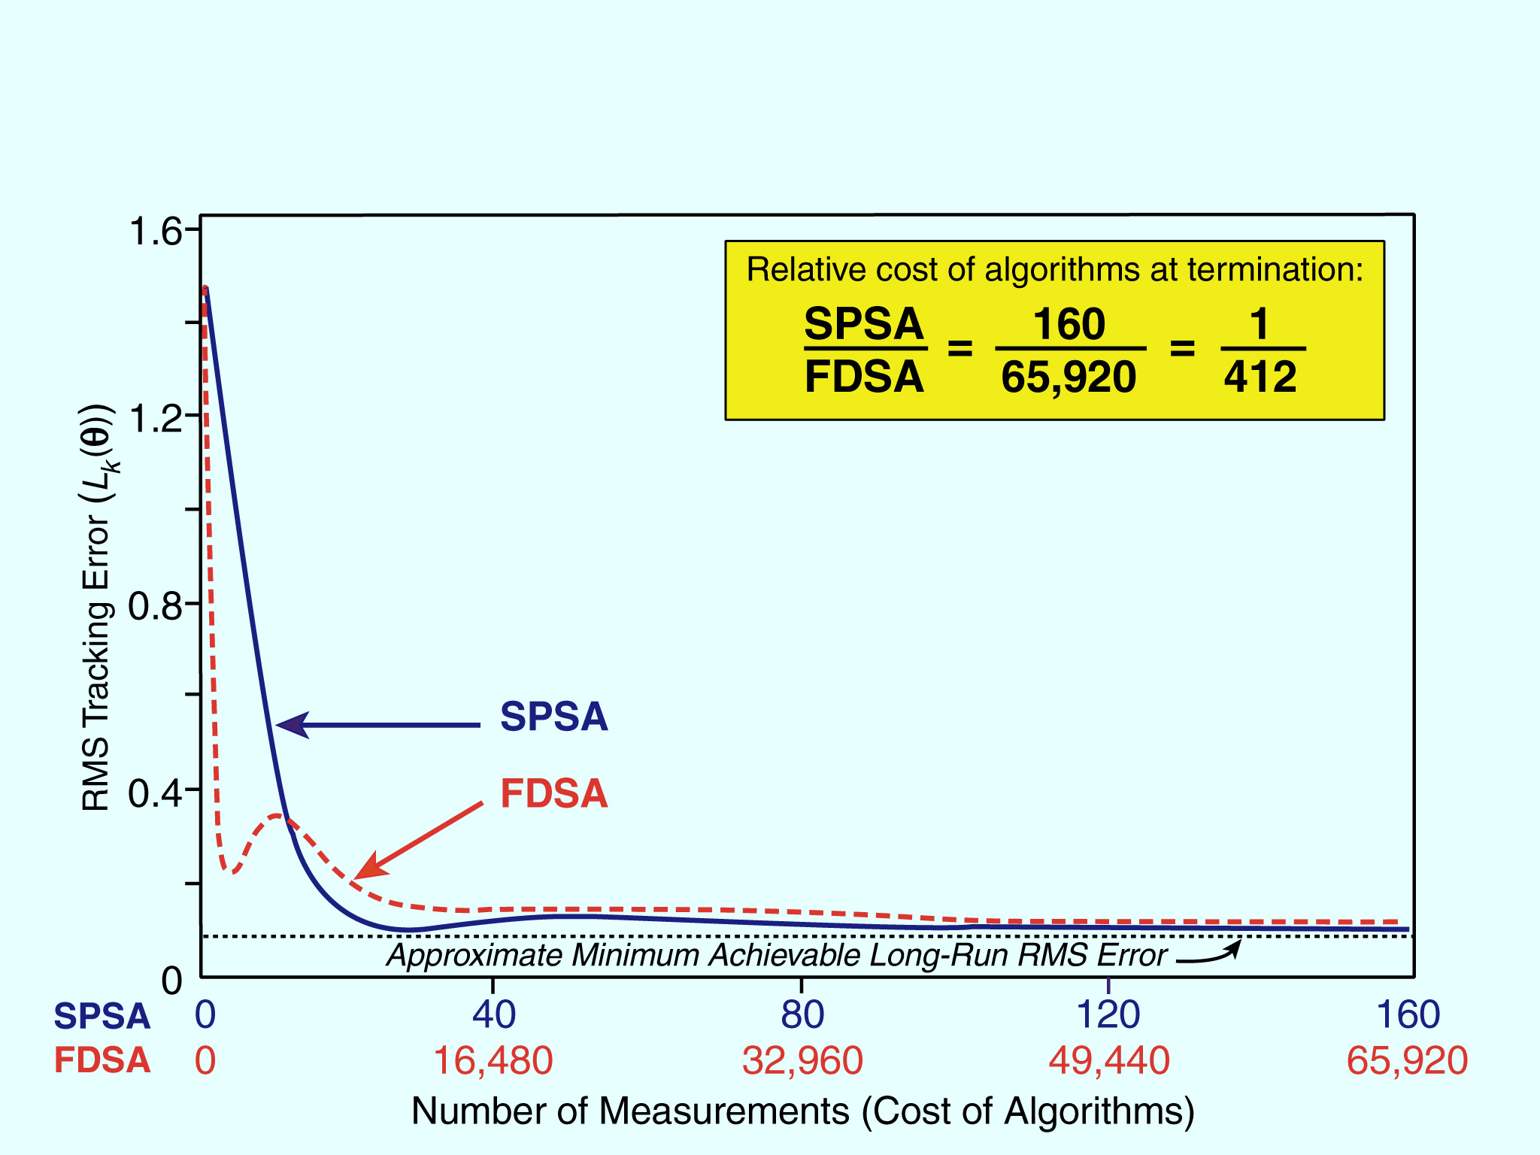
RMS Error for Controller
in Wastewater Treatment Model
7-<number>
7- <number>
0101600-Fig-8.3

Slide 21
E. EXTENSIONS AND FURTHER RESULTS
There are variations and enhancements to “standard” SPSA of Section A
Section 7.7 of ISSO discusses:
  (i) Enhanced convergence through gradient
  averaging/smoothing
  (ii) Constrained optimization
  (iii) Optimal choice of Δ_{k} distribution
  (iv) One-measurement form of SPSA
  (v) Global optimization
  (vi) Noncontinuous (discrete) optimization
7-<number>

Slide 22

(i) Gradient Averaging and Gradient Smoothing
These approaches may yield improved convergence in some cases
In gradient averaging is simply replaced by the average of several (say, q) SP gradient estimates
  This approach uses 2q values of y(•) per iteration
  Spall (1992) establishes theoretical conditions for when this is advantageous, i.e., when lower MSE compensates for greater per-iteration cost (2q vs. 2, q >1)
  Essentially, beneficial in a high-noise environment (consistent with intuition!)
In gradient smoothing, gradient estimates averaged across iterations according to scheme that carefully balances past estimates with current estimate
  Analogous to “momentum” in neural net/backpropagation literature
7-<number>

Slide 23

(ii) Constrained Optimization
Most practical problems involve constraints on θ
Numerous possible ways to treat constraints (simple constraints discussed in Section C)
One approach based on projections (exploits well-known Kuhn-Tucker framework)
Projection approach keeps in valid region for all k by projecting into a region interior to the valid region
  Desirable in real systems to keep (in addition
  to ) inside valid region to ensure physically achievable solution while iterating
Penalty functions are general approach that may be easier to use than projections
  However, penalty functions require care for efficient implementation
7-<number>

Slide 24
(iii) Optimal Choice of Δ_{k} Distribution
Sections 7.3 and 7.4 of ISSO discuss sufficient conditions for Δ_{k} distribution (see also Sections A and B here)
  These conditions guide user since user typically has full control over distribution
  Uniform and normal distributions do not satisfy conditions
Asymptotic distribution theory shows that symmetric Bernoulli distribution is asymptotically optimal
  Optimal in both an MSE and nearness-probability sense
  Symmetric Bernoulli is trivial to generate by Monte Carlo
Symmetric Bernoulli seems optimal in many practical (finite-sample) problems
  One exception mentioned in Section 7.7 of ISSO (robot control problem): segmented uniform distribution
7-<number>

Slide 25
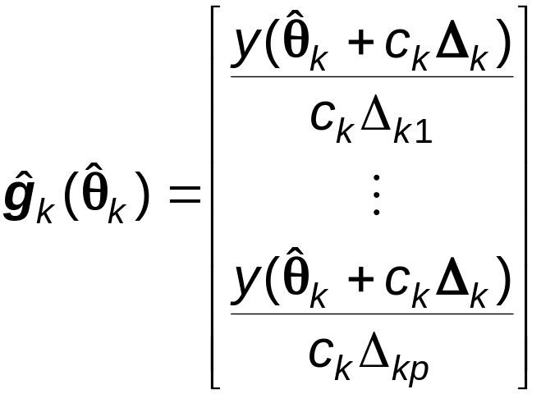


(iv) One-Measurement SPSA
Standard SPSA use two loss function measurements/iteration
One-measurement SPSA based on gradient approximation:
As with two-measurement SPSA this form is unbiased estimate of to within
Theory shows standard two-measurement form generally preferable in terms of total measurements needed for effective convergence
  However, in some settings, one-measurement form is preferable
  One such setting: control problems with significant nonstationarities
7-<number>

Slide 26
(v) Global Optimization
SPSA has demonstrated significant effectiveness in global optimization where there may be multiple (local) minima
One approach is to inject Gaussian noise to right-hand side of standard SPSA recursion:
where b_{k} → 0 and w_{k} ∼ N(0,I_{p×p})
Injected noise w_{k} generated by Monte Carlo
Eqn. (*) has theoretical basis for formal convergence (Section 8.4 of ISSO)
7-<number>

Slide 27
(v) Global Optimization (Cont’d)
Recent results show that b_{k} = 0 is sufficient for global convergence in many cases (Section 8.4 of ISSO)
  No injected noise needed for global convergence
  Implies standard SPSA is global optimizer under appropriate conditions
Numerical demo on some tough global problems with many local minima yield global solution
  Neither genetic algorithms nor simulated annealing able to find global minima in test suite
  No guarantee of analogous relative behavior on other problems
Regularity conditions for global convergence of SPSA difficult to check
7-<number>

Slide 28



(vi) Noncontinuous (Discrete) Optimization
Basic SPSA framework for L(θ) differentiable in θ
Many important problems have elements in θ taking only discrete (e.g., integer) values
There have been extensions to SPSA to allow for discrete θ
  Brief discussion in Section 7.7 of ISSO; see also references at SPSA Web site
SP estimate produces descent information although gradient not defined
Key issue in implementation is to control iterations and perturbations to ensure they are valid θ values
7-<number>

Slide 29
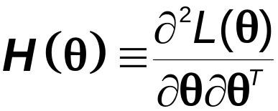
F. ADAPTIVE SIMULTANEOUS PERTURBATION METHOD
Standard SPSA exhibits common “1st-order” behavior
  Sharp initial decline
  Slow convergence in final phase
  Sensitivity to units/scaling for elements of θ
“2nd-order” form of SPSA exists for speeding convergence, especially in final phase (analogous to Newton-Raphson)
  Adaptive simultaneous perturbation (ASP) method (details in Section 7.8 of ISSO)
ASP based on adaptively estimating Hessian matrix
Addresses long-standing problem of finding “easy” method for Hessian estimation
Also has uses in nonoptimization applications (e.g., Fisher information matrix in Subsection 13.3.5 of ISSO)
7-<number>

Slide 30
Overview of ASP
ASP applies in either
  (i) Standard SPSA setting where only L(θ) measurements are available (as considered earlier) (“2SPSA” algorithm)
  or —
  (ii) Stochastic gradient (SG) setting where L(θ) and g(θ) measurements are available (“2SG” algorithm)
Advantages of 2nd-order approach
  Potential for speedier convergence
  Transform invariance (algorithm performance unaffected by relative magnitude of θ elements)
Transform invariance is unique to 2nd-order algorithms
  Allows for arbitrary scaling of θ elements
  Implies ASP automatically adjusts to chosen units for θ
7-<number>

Slide 31
Cost of Implementation
For any p, the cost per iteration of ASP is
Four loss measurements for 2SPSA
⎯ or ⎯
Three gradient measurements for 2SG
Above costs for ASP compare very favorably with previous methods:
O(p²) loss measurements y(•) per iteration in FDSA setting
(e.g., Fabian, 1971)
O(p) gradient measurements per iteration in SG setting
(e.g., Ruppert, 1985)
If gradient/Hessian averaging or y(•)-based iterate blocking is used, then additional measurements needed per iteration
7-<number>

Slide 32


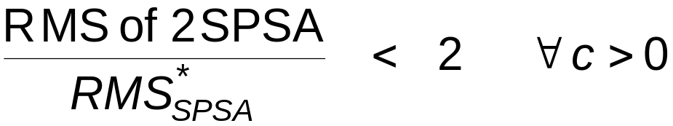
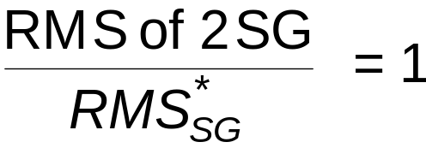
Efficiency Analysis for ASP
Can use asymptotic normality of 2SPSA and 2SG to compare asymptotic RMS errors (as in basic SPSA) against best possible asymptotic RMS of SPSA and SG, say
and
2SPSA: With a_{k} =1/k and c_{k} = c /k^{1/6} (k ≥ 1)
2SG: With a_{k} = 1/k and any valid c_{k}
Interpretation: 2SPSA (with a_{k} = 1/k) does almost as well as unobtainable best SPSA; RMS error differs by < factor of 2
2SG (with a_{k} = 1/k) does as well as the analytically optimal SG (rarely available)
7-<number>

